Slide 1

Open Technology Workshops
HARDWARE
Using technology sustainably

Slide 2
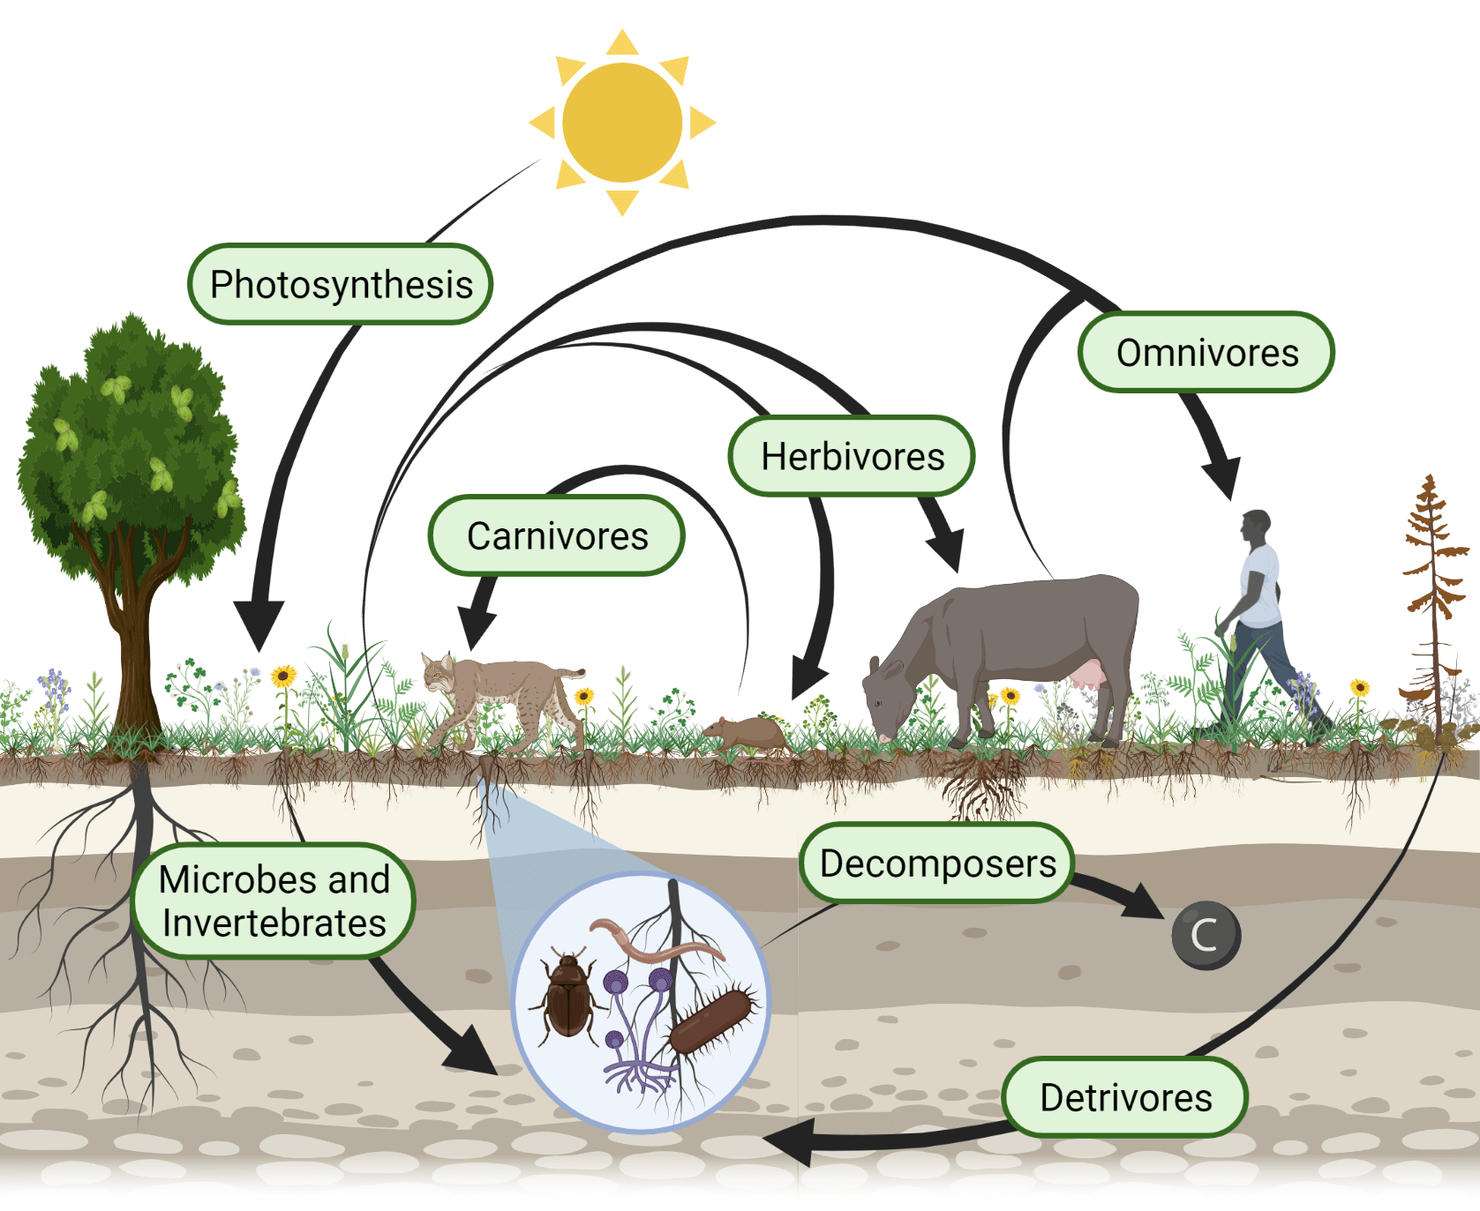
Open Technology Workshops
What we need to survive
All living things use energy and certain matter to live. In a closed system, energy and matter (food) are inherently scarce. This gives rise to the circle of life and the food chain.
But if a closed system is large enough, like the Earth, it appears open and infinite...
Image source: https://www.noble.org/regenerative-agriculture/optimize-energy-flow-on-your-ranch/

Slide 3
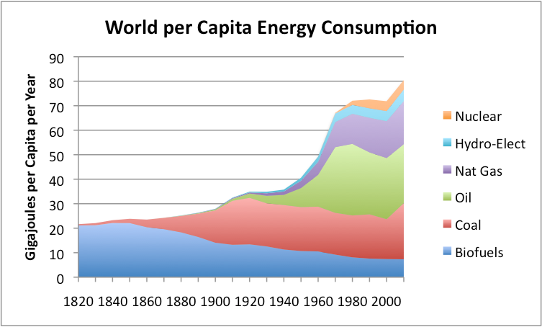
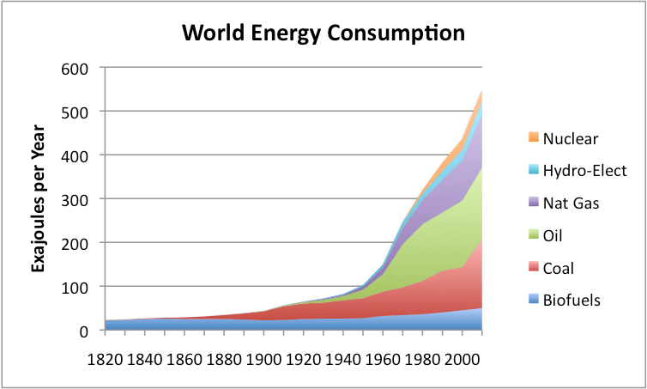
Open Technology Workshops
The energy we use
Humanity’s industrialization and technology has enabled us extract more resources from our planet than ever before. And since capitalism is predecated on the notion of infinite growth, our rate of consumption has become unsustainable. Most of this consumption is in the form of fossil fuels.
Image source: https://ourfiniteworld.com/2012/03/12/world-energy-consumption-since-1820-in-charts/

Slide 4
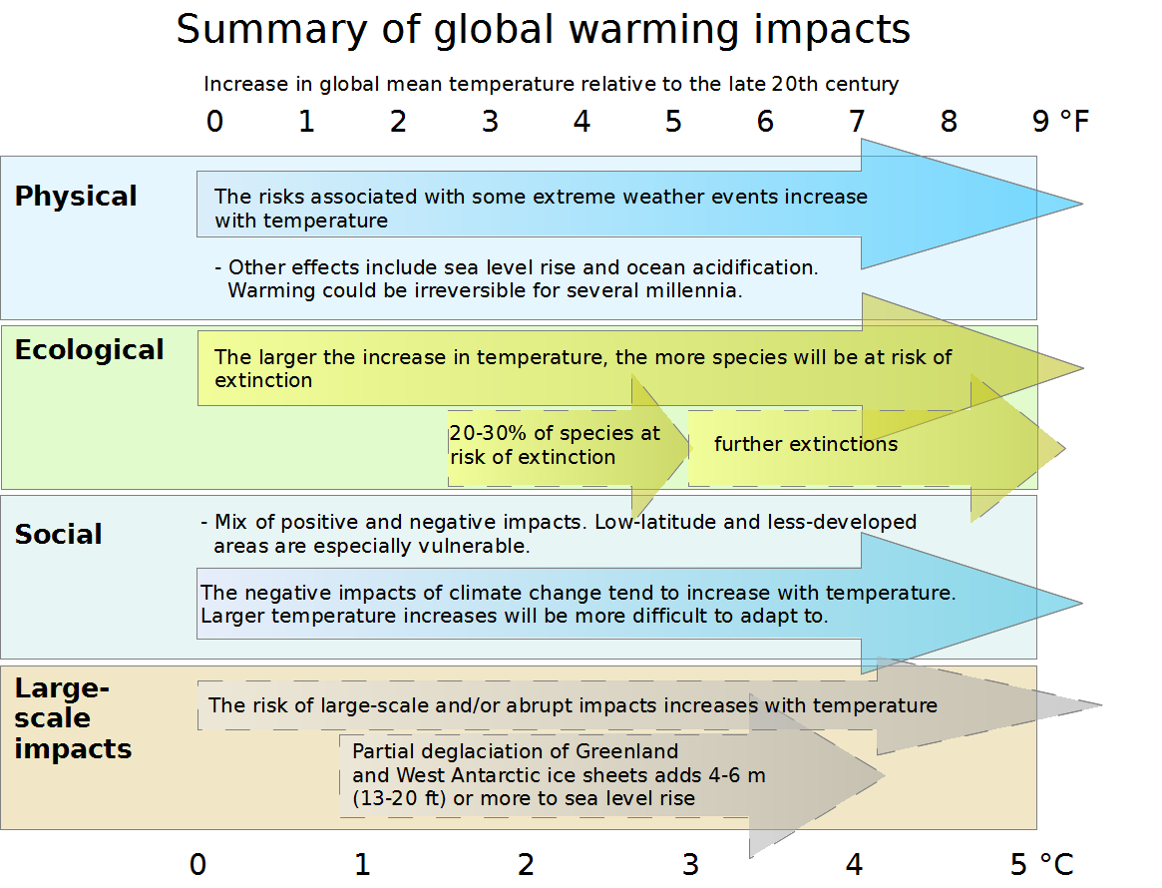
Open Technology Workshops
What if we use too much?
The consequenses of this are:
climate change,
envinromental degredation,
mass extinctions,
and more...
Image source: https://commons.wikimedia.org/wiki/File:Effects_of_global_warming,_plotted_against_changes_in_global_mean_temperature.png

Slide 5

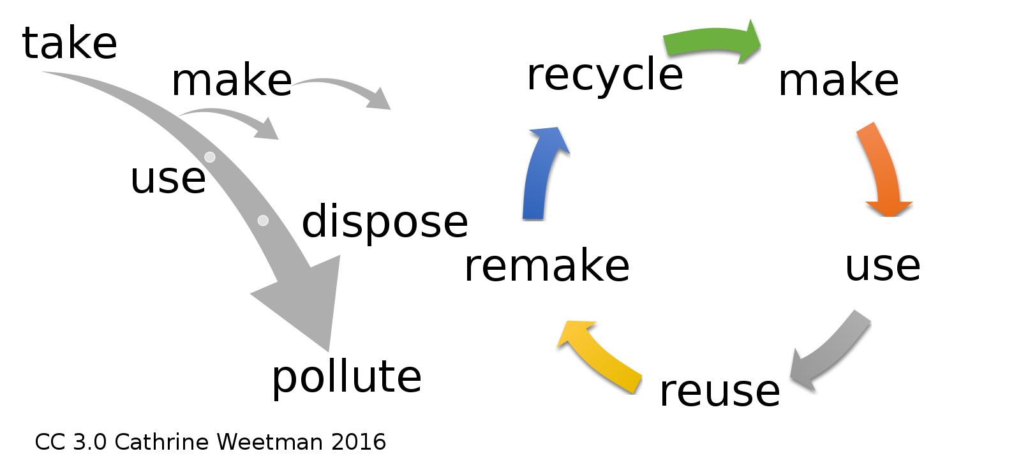
Open Technology Workshops
What is sustainability?
Sustainability aims to achieve a balance of the matter and energy we consume with the natural environment.

Slide 6
Open Technology Workshops
What can I do?
In your home | Power generation | Food and water | Repair and maintainence
Smart thermostats | rechargable batteries and solar chargers | Automatic plant watering | Sewing machines
Heat pumps | Solar panels and home battery backup | Aerogarden, hydroponics | 3D printers
Efficient lighting and appliances, | Smart electrical panels | Fully robotic gardening system | Repairable products
High efficiency windows, insulation | DIY wind turbines and river turbines | Canning and food preservation | Upcycling
Watt meters and smart plugs |  |  | “Buy nothing” groups
Full utility electrification

Slide 7
Open Technology Workshops
Where to find more info
More resources
https://www.libretechnica.org/docs/individuals/sustainability_challenge/
Dear Alice commercial - https://www.youtube.com/watch?v=z-Ng5ZvrDm4
Thank you for coming!

Slide 8
Open Technology Workshops
LibreTechnica welcomes Tinker!

